Slide 1

Integrate Power BI with the Text Analytics Cognitive Service
Polkampally Revanth
200424001

Slide 2
Cognitive Service
Set of machine learning algorithms that Microsoft has developed to solve problems in the field of Artificial Intelligence (AI).

Slide 3
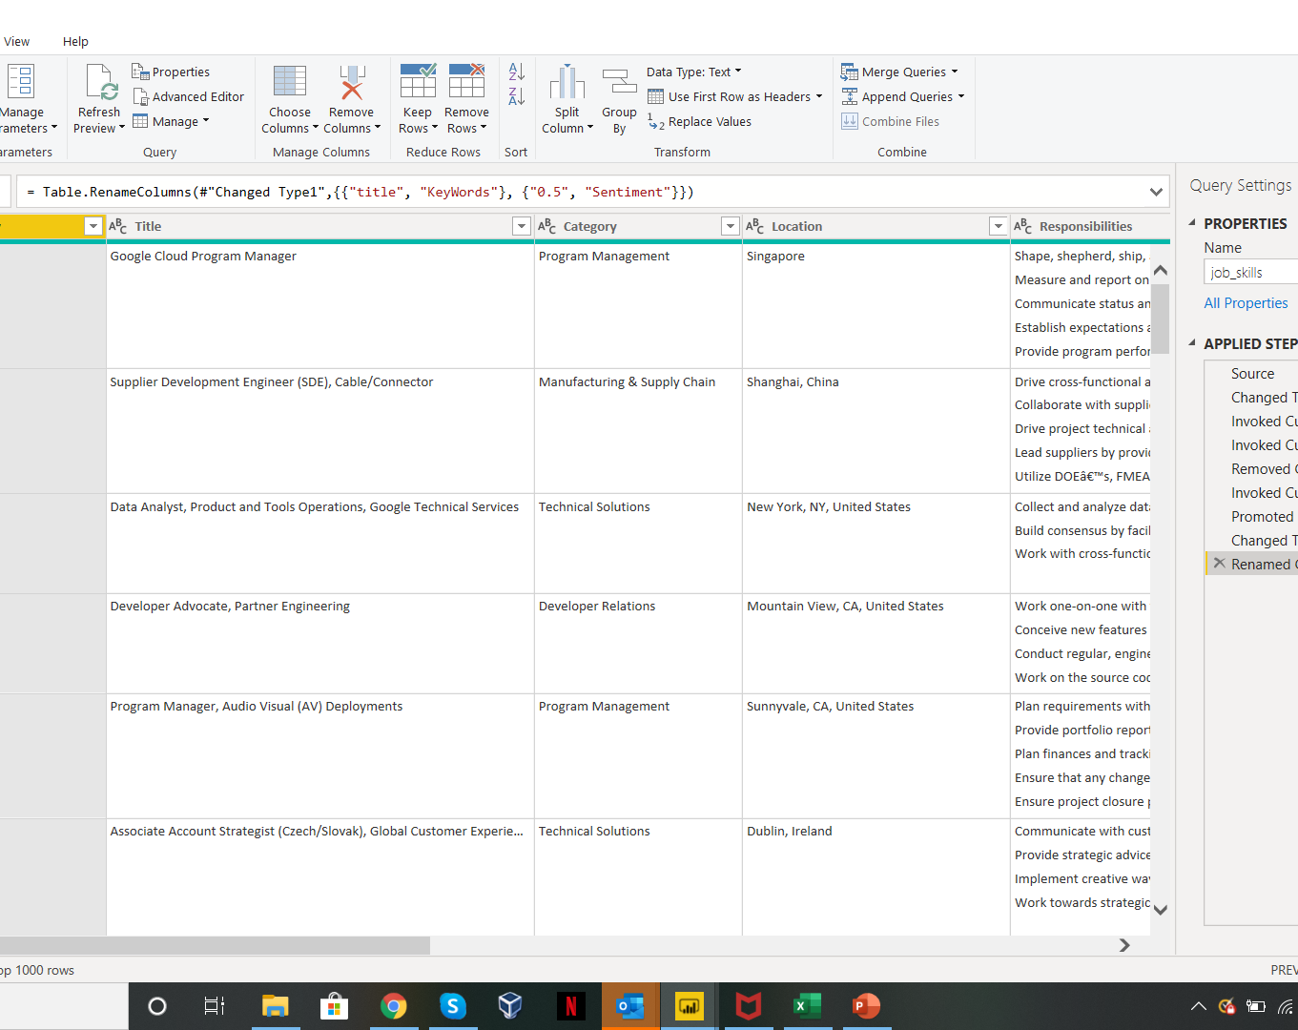
Data Description
Number of Records – 1251
Number of Columns – 7

Slide 4
Workflow
Generate API Key and Endpoint In Azure.
Load the dataset to Power BI.
Prepare the data
Create Custom function
Text Analytics services

Slide 5
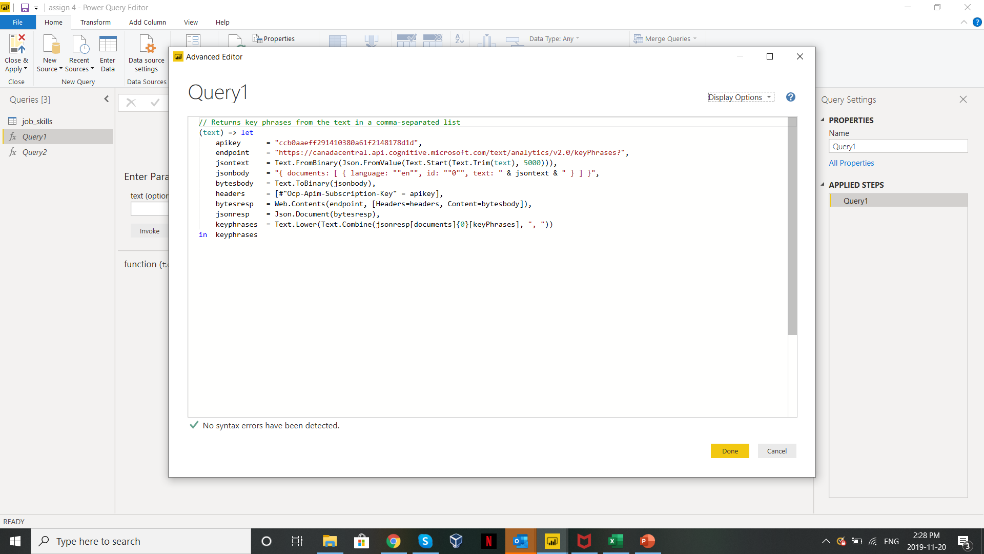
Custom Function:

Slide 6
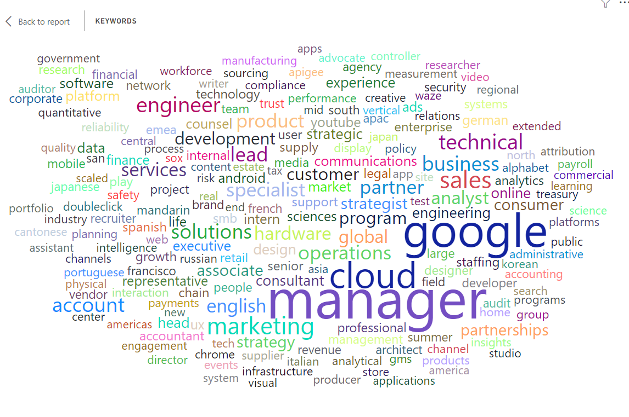
Word Cloud

Slide 7

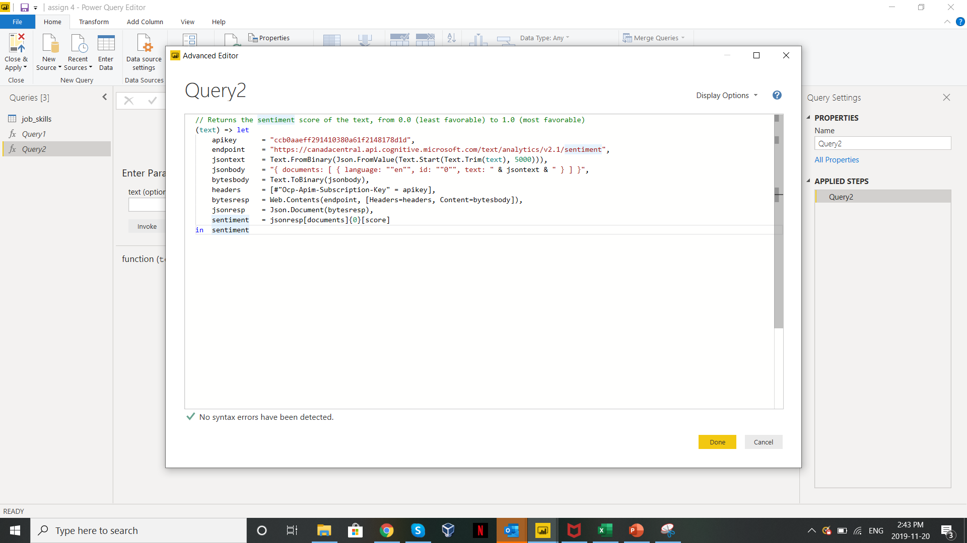


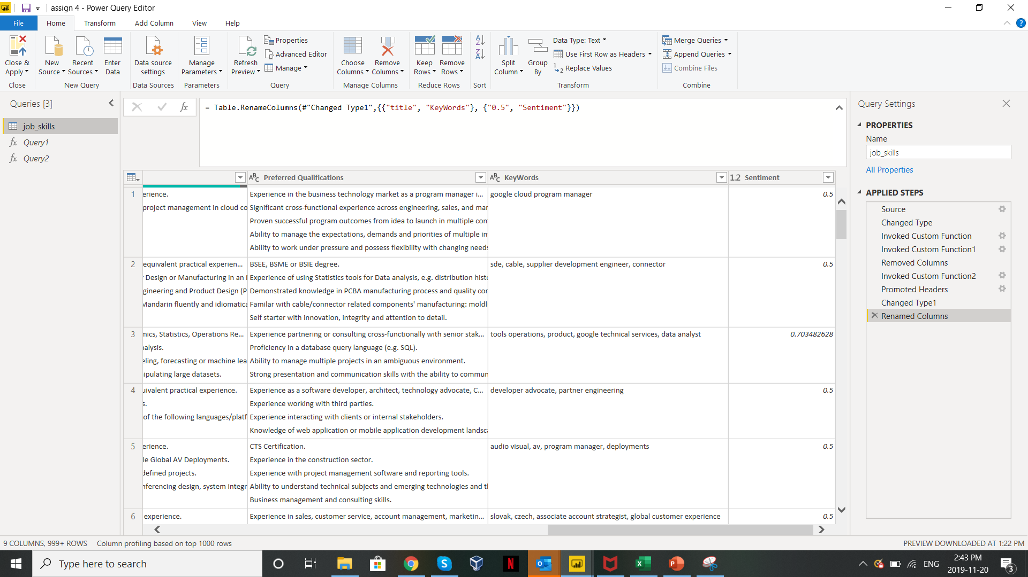

Sentiment Analysis:

Slide 8
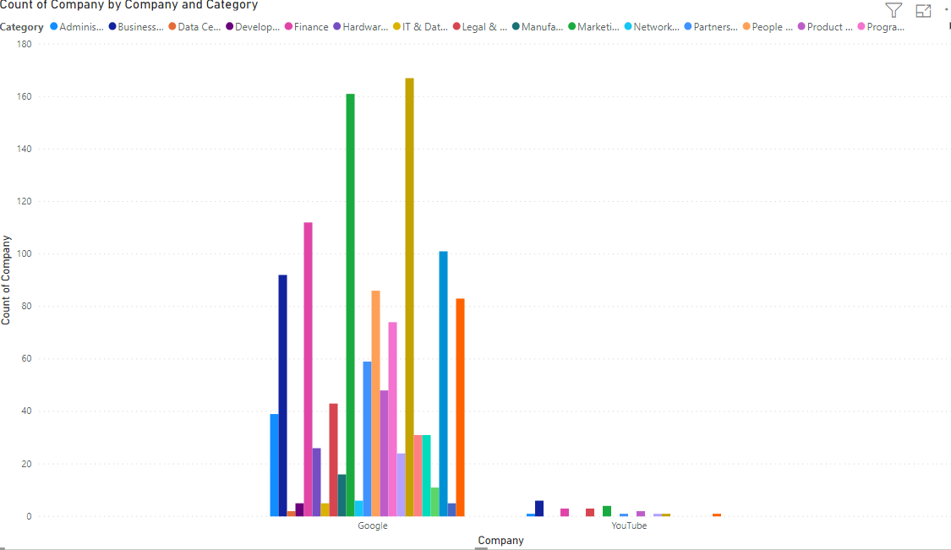
Visualization:

Slide 9
Thank You

